Slide 1
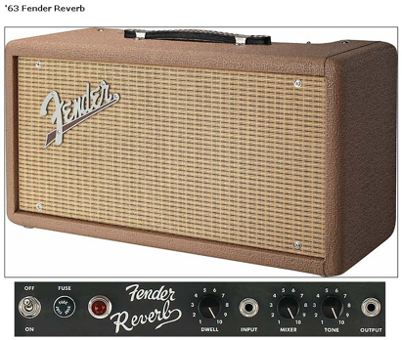
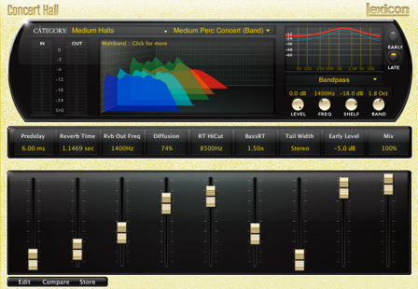
Reverberation modelling – mechanical, physical and room models

Slide 2
Reverb modeling
Physical
Reverberation chambers
Mechanical & physical
Reverberation chambers
Spring reverb
Plate reverb
Room modeling
Ray tracing, Beam tracing, Finite boundaries
Image source method

Slide 3
Reverberation chambers
Studios use rooms to add reverb to recordings
Elevator shafts and stairwells work as highly reverberant environments
Reverb controlled by adding some absorptive materials
Curtains can be drawn across more reflective surfaces

Slide 4
Spring Reverbs
used in Hammand organs and many guitar amplifiers
Spring enclosed in metal box, reverb pan
pan takes audio and produces reverberated version
mixed with dry signal
transducer converts energy in one form to another
Spring driven at one end by input audio signal
Electrical energy converted to mechanical energy
Pickup records vibrations on other end of spring
Mechanical energy back to electrical energy
other transducers are pickups on guitar, microphones, speakers..
Waves travel and reflect through spring
When wave arrives at end, part of wave energy reflected and stays in spring
reflections create reverb characteristic sound

Slide 5
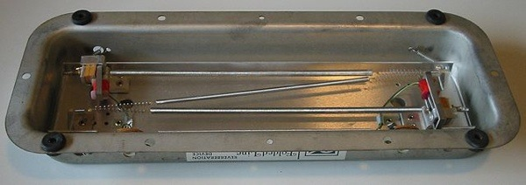
Spring Reverb Implementation
Often several springs used together
Each spring different length or different tension to avoid uniform behavior in single spring
reflections occur at different times
increases 'randomness' of echoes
spring lengths & tensions are usually fixed in design process, and not left to user to control
spring reverbs sensitive to motion
If you drop amplifier, hear twangy, spring-like sound
results when springs hitting case or other springs

Slide 6
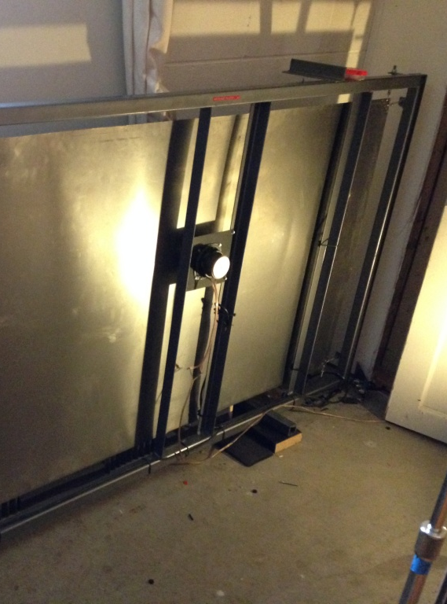
Plate Reverb
not used widely outside of studio
expensive and bulky
similar to spring reverb
instead of connected to springs, 2 or more transducers
connected to different points on metal plate.
Transducers send vibration waves throughout plate
Reflections occur each time wave reaches edge of plate
reverberation controlled by adjusting damping of plate
and location of transducers

Slide 7
Other methods
many ways to create reverb effects
not used often
tape based reverb units.
inherently periodic behavior due to tape loop
multiple playback heads used to disguise this
Other acoustical structures can be used
pipes with microphones placed at various points
interesting to create and use
difficult competing against digitally based reverbs as far as simplicity and ease

Slide 8
Modelling room reverberation
Inputs include
Geometry of room
Sound source location
Listener location
Algorithms model specific room properties
Ray tracing techniques
follow paths of sound waves
Beam tracing
Trace beams (bundles of rays) from sources
Boundary elements methods
Solve wave equations over surfaces
Image source method

Slide 9
Image source method
Microphone
Source
Virtual source
A room with source sound and microphone, and its mirror image containing a virtual source

Slide 10
Image source method
room with multiple mirror images in two dimensions
corresponding to reflections of sound source off of the walls

Slide 11
Image source method
circle drawn to indicate virtual sources used for early reflections

